Slide 1
Case Study 4
Tobias Chin, Ryan Dalton, Jacob Ruppert, Rohan Prasad, and Bishoy Soliman Hanna
Notes:
Tobias

Slide 2
Business Model
Notes:
Jacob

Slide 3
Business Model
Our business specializes in leveraging machine learning algorithms to produce sentiment analysis and public relations findings; by providing these services we can empower the PR departments of small to medium sized businesses with new opportunities for strategic decision-making and effective reputation management.
What problem are we solving?
Why is this problem important to solve?
How will we solve this problem?
What sets us apart from the competition?
Notes:
Jacob
Explain model and answer the questions on the next slide…

Slide 4
Our Business Model:
Our business specializes in leveraging machine learning algorithms to produce sentiment analysis and public relations findings; by providing these services we can empower the PR departments of small to medium sized businesses with new opportunities for strategic decision-making and effective reputation management.
Key Partners
Key Activities
Value Prop.
Customer Relations
Customer Segments
NewsAPI
Hugging Face
Run sentiment analysis using ML algs for smaller PR departments
Cost effective sentiment analysis of articles and potentially social media posts about our customer’s company
Standard customer services
We assist small/medium internal PR departments
Key Resources
Channels
Articles for analysis
Processing power to run our models
We’ll contact and work with our customers virtually, likely over a website and zoom
Cost
Revenue Streams
Standard expenses for payroll, rent, etc.
Expenses for NewsAPI, cloud computing/storage, etc.
We’d contract our services to PR departments
We’d also offer a subscription
Notes:
Jacob
What problem are we solving?
We hope to utilize machine learning algorithms to empower internal PR departments and provide them with resources they would traditionally have to outsource to global firms to have access to?
Why is this problem important to solve?
PR is a key component of almost every modern company; while large companies can afford global PR firms to manage their image, smaller businesses find themselves at a disadvantage as they can’t afford to outsource.
How will we solve this problem?
If we can produce perception recognition and sentiment analysis findings using ML algorithms we can provide the PR departments of small to medium sized businesses with new opportunities for strategic decision-making and effective reputation management.
What sets us apart from the competition?
Our competition are large global communications/PR firms but we can avoid directly competing by targeting smaller-sized businesses. We are focusing on an existing gap in the industry: small to medium businesses are in need of better tools for PR analysis but currently the only way to gain access to these resources is by outsourcing their departments to expensive firms, by offering affordable ML resources we can help these smaller departments make strategic public relation decisions.

Slide 5
Example Business Problem
Notes:
Bishoy
This is a realistic fictional example of our business model in practice

Slide 6
Uber
Uber has hired us to produce findings on their current public perception…
We’ll be producing findings using 1272 articles pulled using NewsAPI that mention “Uber” between 11/15 and 12/1
We’ll also use the Ola Vs Uber Play store reviews dataset from Kaggle, this dataset contains >1,000,000 Ola and Uber reviews but we’ll only be using 1000 Uber reviews.
Notes:
Bishoy

Slide 7
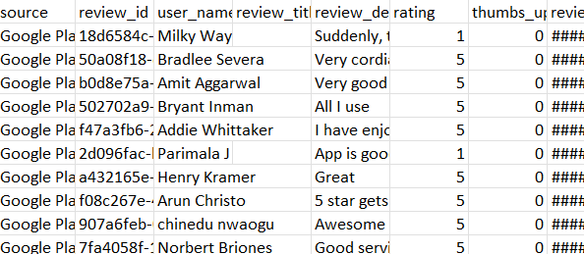
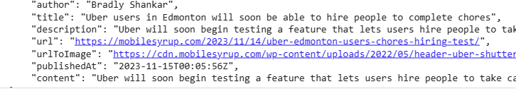
Data
The kaggle dataset:
Each review had a source, review_id, user_name, review_title, review_description, rating, thumbs_up, etc.
For our sentiment analysis we only used the review_description
The NewsAPI articles:
Each article had an author, title, description, url, image, and date
For our sentiment analysis we analyzed the descriptions and titles of the articles
Notes:
Ryan

Slide 8
Machine Learning Models
NLTK (Natural language Processing):
We used VADER, a NLTK text sentiment analysis tool
Hugging Face (Deep Learning):
We used the AdamCodd/distilbert-base- uncased-finetuned-sentiment-amazon, this model was trained using amazon reviews
Notes:
Rohan
VADER (Valence Aware Dictionary and sEntiment Reasoner)

Slide 9
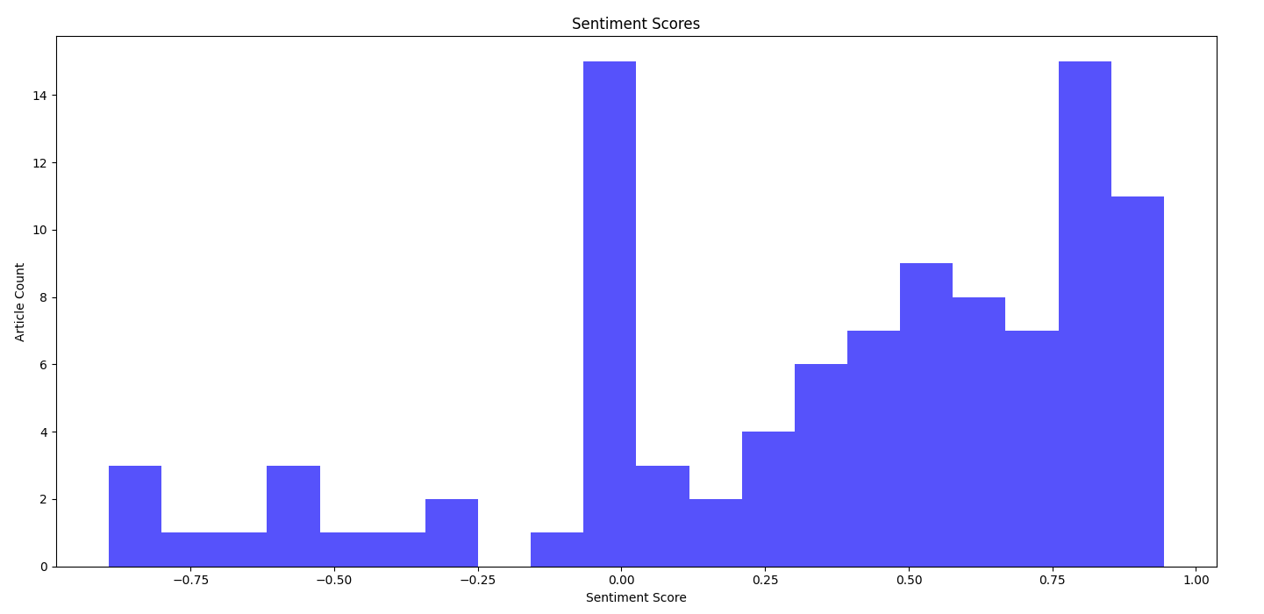
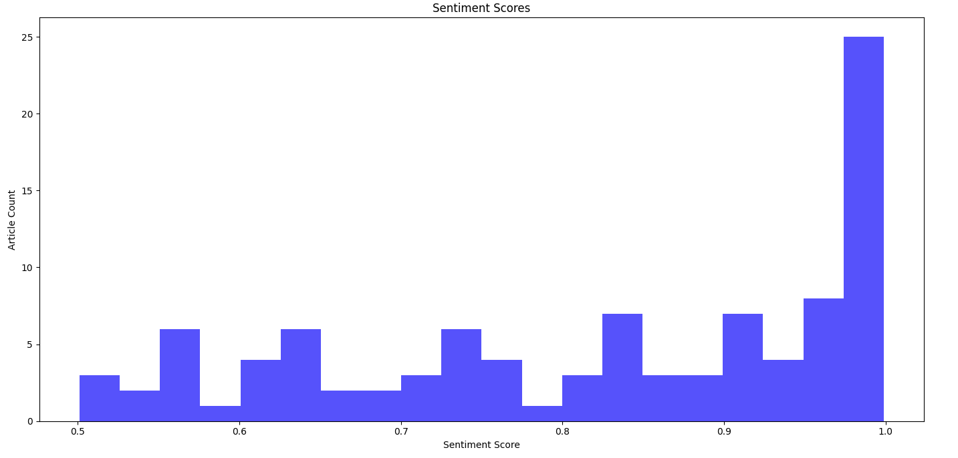
NewsAPI Results
NLTK (Natural language Processing):
Hugging Face (Deep Learning):
Notes:
Rohan
VADER identified more of the articles as positive and neutral while Hugging Face identified very few negative and neutral and significantly more as positive

Slide 10
Interpreting The Data
Hugging Face: Positive, 0.84
NLTK: Negative, -0.83
Examples like this reflect how the NLTK model is generally better suited to this problem, this article is clearly negative towards the burnout and pay stemming from Uber.
Notes:
Rohan

Slide 11
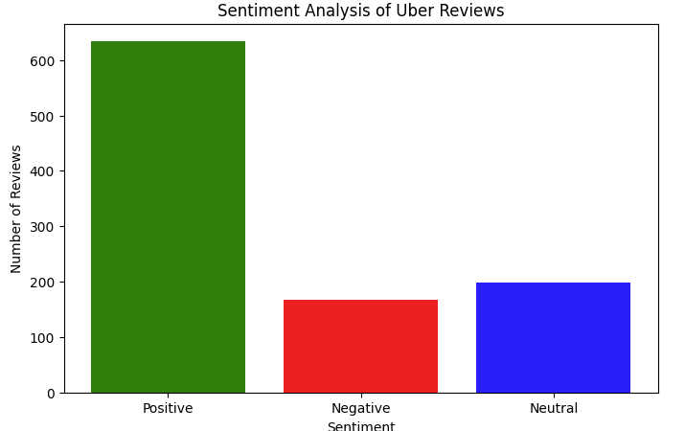
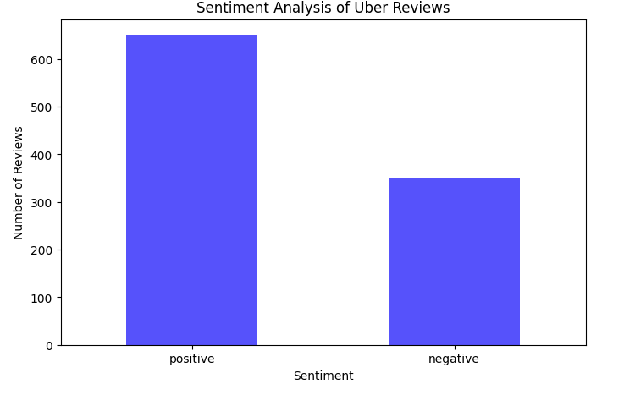
Kaggle Results
NLTK (Natural language Processing):
Hugging Face (Deep Learning):
Notes:
Jacob
As you can tell something isn’t right about the bottom graphic, …

Slide 12
Interpreting The Data
While both models had a comparable amount of positives; the NLTK also included neutral sentiments.
While the results are similar, the NLTK model takes significantly less time to run meaning it was still the superior model for this example.
Notes:
Jacob

Slide 13
Conclusions
The NLTK model was notable faster and preformed better/comparable for both datasets…
We can confirm Uber is generally well reviewed with a average sentiment of 0.31
The articles are also overall positive with a average sentiment of 0.16
If we had more time…
We could find/fine-tune a more optimal Hugging Face algorithm and produce more insightful conclusions about the business
Notes:
Tobias

Slide 14
Thank You!
Any Questions?
Notes:
Jacob

Slide 15
90 Second Pitch
Notes:
Jacob

Slide 16
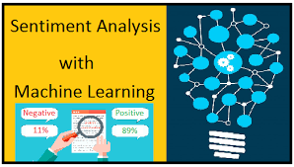
Identify the problem/real world application
-Growing industry for small companies looking for enhanced efficiency and effectiveness in their PR firms using in house strategies
-more control than outsourcing
Product overview
-machine learning algorithms to produce sentiment analysis and public relations findings as a service(subscription based)
-Cheaper and more personalized than outsourcing
Unique Selling Points (USPs):
-Benefits small to medium size PR departments
-real-time insights
-improved decision-making
-enhanced brand reputation management.
SAWML App
Notes:
Tobias

Slide 17

Next steps/advancements
What’s next…
Increased scale and implementation
handle larger datasets and algorithms
gain more insight into PR
Notes:
Tobias

